Slide 1

Lic. en Sistemas
Inglés Nivel 1

Slide 2


Unit 3
Websites

Slide 3
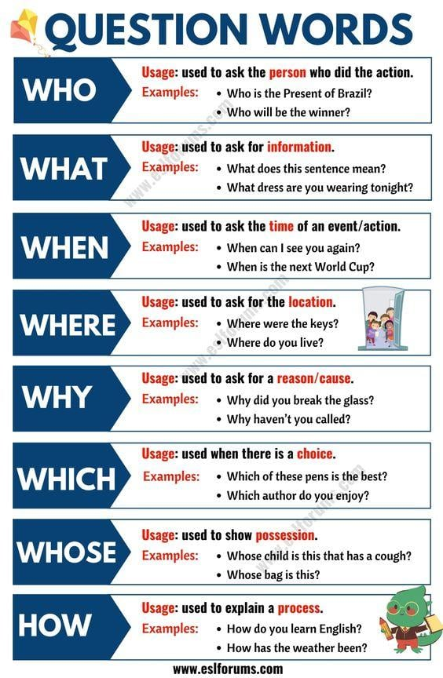

Slide 4
Fill in the question words What, Where, Why, When, How, Who
to form the question.
__________ do you like best?
__________ does Manolo get up in the morning?
__________ don´t you go by bus, Cristina?
__________ hobbies does Carlos like?
__________ do they go to every week?
__________ old are you Silvia?
__________ is Maria´s birthday?
__________ are my exercise books?
__________ are you doing at the moment, Harry?
__________ do the Petersons live?
10. _______ was your first word as a baby? Mama.
11. _______ were you born? On March 9th.
12. _______ were you born? In St. Maarten.
13. _______ were you last Sunday? I was working.
14. _______ can we have a picnic? I know a nice place near a pond.
15. _______ are you going to take with you? Some sandwiches and a coke.

Slide 5
Complete the questions with these words (When, Where, Who, What). 1. ________ is your favourite singer? 2. ________ is your house? 3. ________ is your favourite day of the week? 4. ________ is your favourite colour? 5. ________ are your English lessons? 6. ________ is your favourite movie? 7. ________ are you from? 8. ________ is near you house? 9. ________ do you live? 10. ________ is your favourite type of music?
Complete the questions with these words (When, Where, Who, What).
________ is your favourite singer?
________ is your house?
________ is your favourite day of the week?
________ is your favourite colour?
________ are your English lessons?
________ is your favourite movie?
________ are you from?
________ is near you house?
________ do you live?
________ is your favourite type of music?

Slide 6
